Slide 1

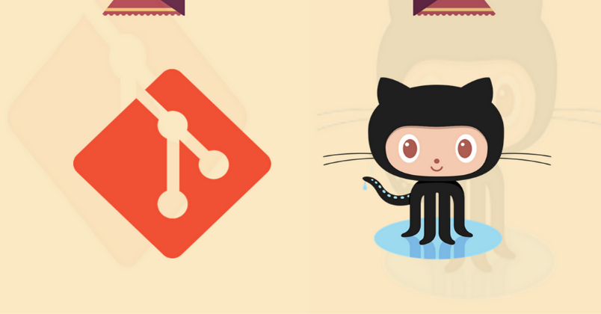
Git and GitHub
Qasir Hassan
MCA 2nd Sem
Roll No: 040
Github.com/sahilqaiser

Slide 2
What is GIT?
GIT is a Version Control System for tracking changes in computer files and coordinating work on those files among multiple people.
~ Wikipedia

Slide 3
Special Features of GIT :
Git is a Distributed VCS.
Git Coordinates work between multiple Authors.
Git keeps track of changes with extra details like Author, Timestamp, change Type etc.
Git can help you revert back any change.
Git can work Offline too.

Slide 4
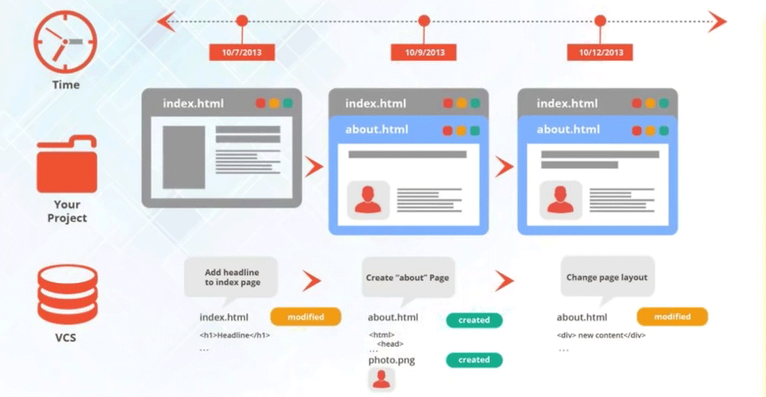
GIT

Slide 5
GIT HOW?
Git Takes SNAPSHOTS of the Files and Folders (i.e. Project).
We Can visit any of these SNAPSHOTS anytime.
We can Stage File Before SNAPSHOTING them.
SO WHAT ARE SNAPSHOTS???

Slide 6
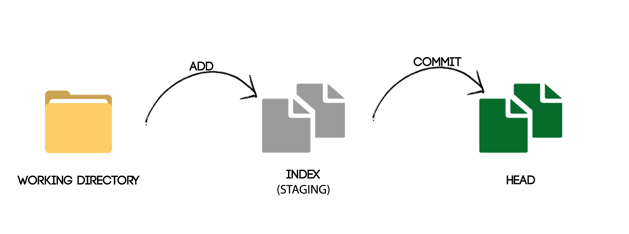
GIT HOW?

Slide 7
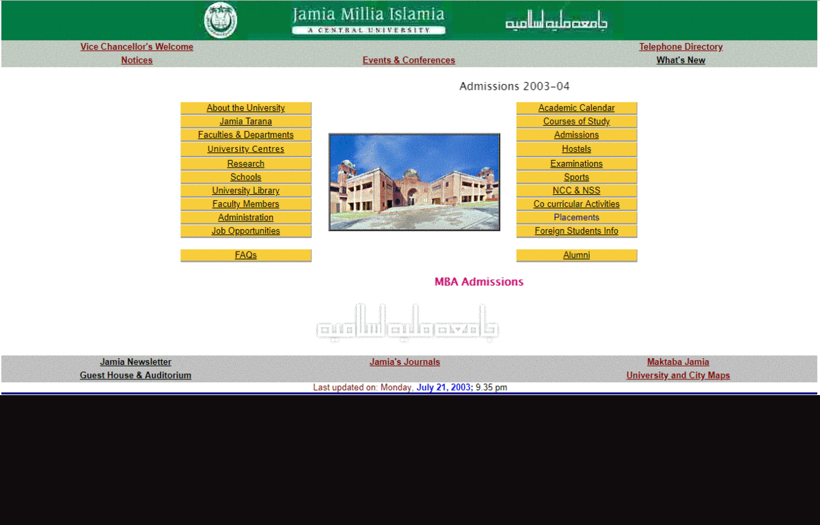

Slide 8
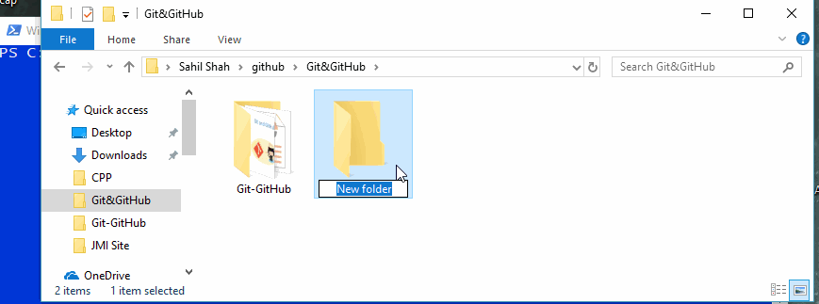
Git Commands
1 - Git init

Slide 9
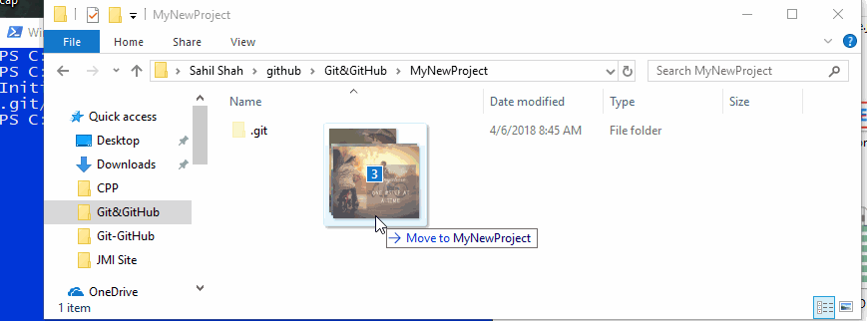
Git Commands
2 - Git add

Slide 10
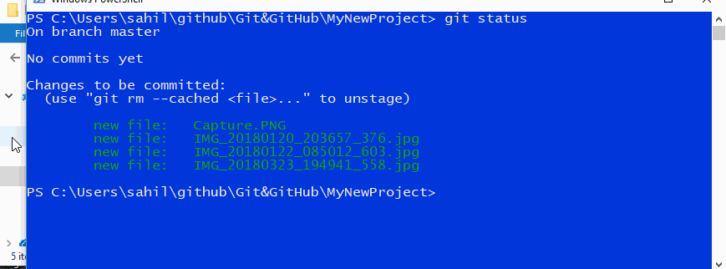
Git Commands
3 – Git COMMIT

Slide 11
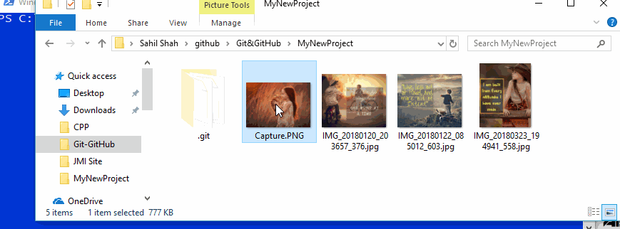
Git Commands
4 – Git Checkout

Slide 12

What is GitHub?

Slide 13
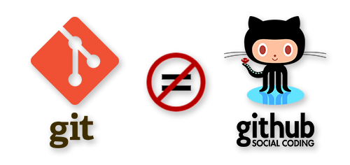
What is GitHub?

Slide 14
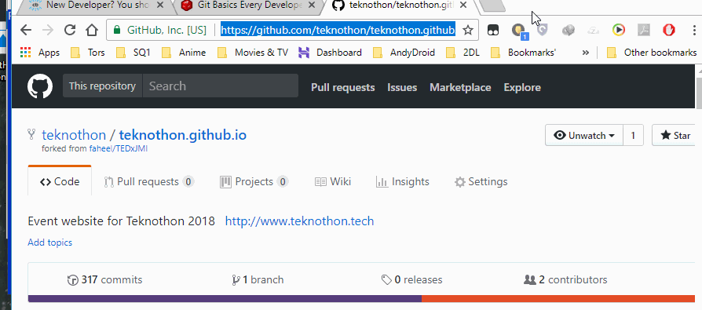
Using GitHub
1 - Git Clone

Slide 15
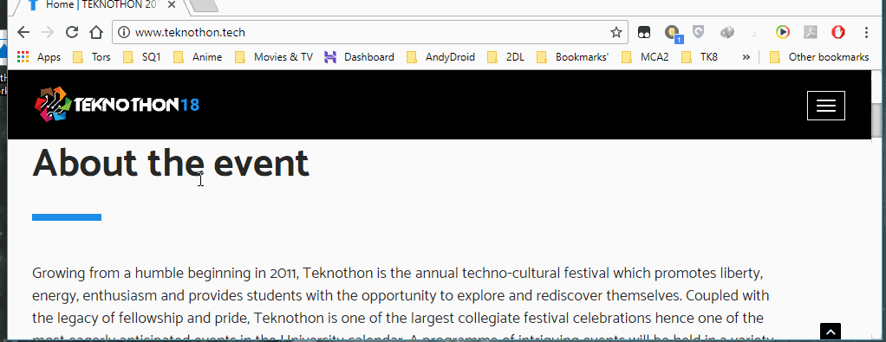
Using GitHub
2 - Fork

Slide 16
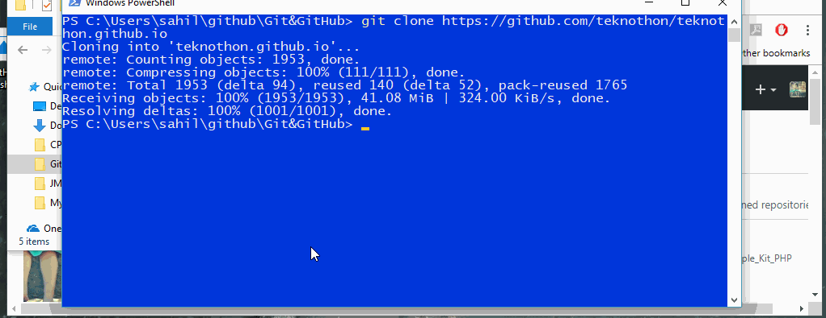
Using GitHub
3 – Git PUSH

Slide 17
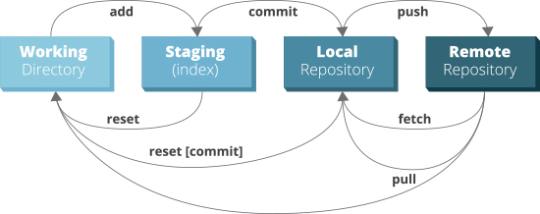
REVISION ☺

Slide 18
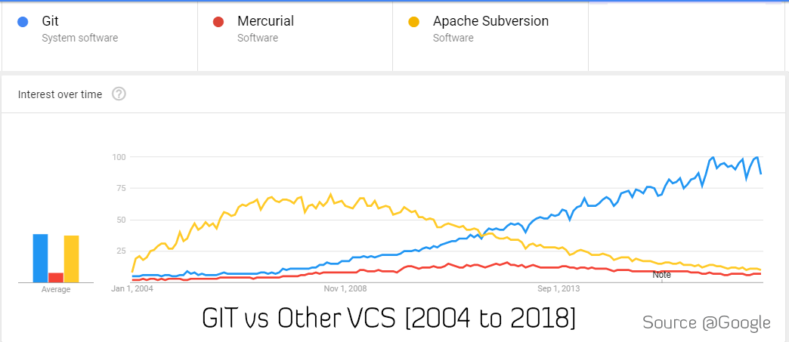
Git vs Other VCS

Slide 19
Takeaway Points
Use GIT to Manage your team projects.
Get Involved in the Worlds Largest OpenSource Community
Bettering your past code
Show OFF ☺☺☺
Learn Git! You are going to Use it Anyway in future

Slide 20
Learning Objective
Got a deeper Understanding of VCS and GIT
Learnt to make GIFs to be used in PPTs
Tried other VCS, and learnt that GIT is best ☺

Slide 21
Conclusion
Try Following Links to learn Git
try.github.io
http://sahilqaiser.tech/git/
https://git-scm.com/book
http://bit.ly/SQ-GitPPT

Slide 22

Thank You ☺
Keep Using GIT… Peace ☺

